Slide 1
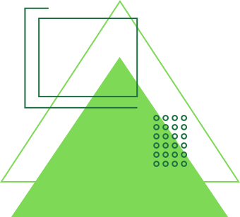
GreenSort
presented by INNOVA

Slide 2
Our Team
Sagarika Srivastava 44 231P047
Bushra Ansari 3 231P046
Sidra Solkar 43 231P087
Sidra Shaikh 40 231P064

Slide 3
ABSTRACT
An IoT-based Wet and Dry Waste Segregation Device is an intelligent system designed to automate the classification of waste into wet (organic) and dry (inorganic) categories using advanced sensor technology and machine learning. The device employs moisture sensors, infrared sensors, gas sensors, and image recognition to accurately identify waste types and direct them into the appropriate bins using motorized flaps. Integrated with microcontrollers such as Arduino, the system processes real-time data and transmits waste analytics to a cloud-based platform for monitoring and optimization. Wireless connectivity via Wi-Fi allows remote tracking of waste levels and timely collection alerts through a mobile or web-based interface. By enhancing waste segregation efficiency, reducing human effort, and promoting recycling, this IoT solution contributes to sustainable waste management in smart cities, households, industries, and public spaces.

Slide 4
Hardware Components:
1.Moisture Sensors
2.Infrared (IR) Sensors
3.Gas Sensors (MQ Series)
4.Load Cells
5.Camera Module
6.Arduino & ESP32
7.Servo Motors
8.Conveyor Belts
9.Battery
Software Components:
1.Arduino Cloud - MQTT & WEBSITE

Slide 5
Components for garbage segregation
1. Display(LCD and LEDs)
2. Power supply (transformer,diodes and capacitors), battery
3. Switch, camera, push buttons, Cables, screws and bolts etc , load cells
4. Resistors capacitor
5. Sensors and input device - ultrasonic , gas sensors
6. IC and ic sockets
7. Arduino Esp32, mqtt and Arduino cloud
8. Servo motors
9. Conveyor belts
10. Crystall oscillator

Slide 6
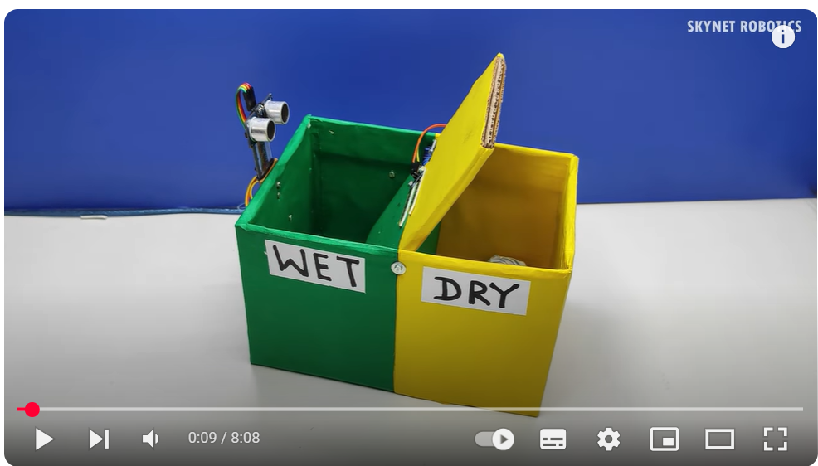
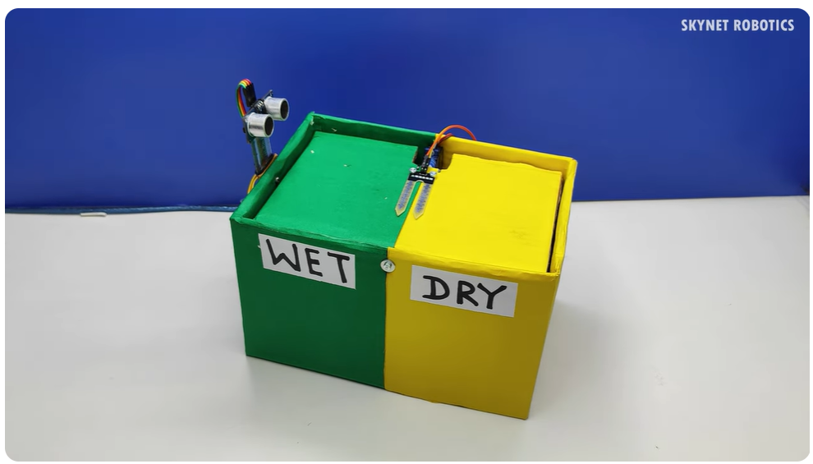

Slide 7
Thank You!

